Slide 1
Design Review 1
Group 17
By Eddie, Ketan, Sunny, Tim, Eric

Slide 2
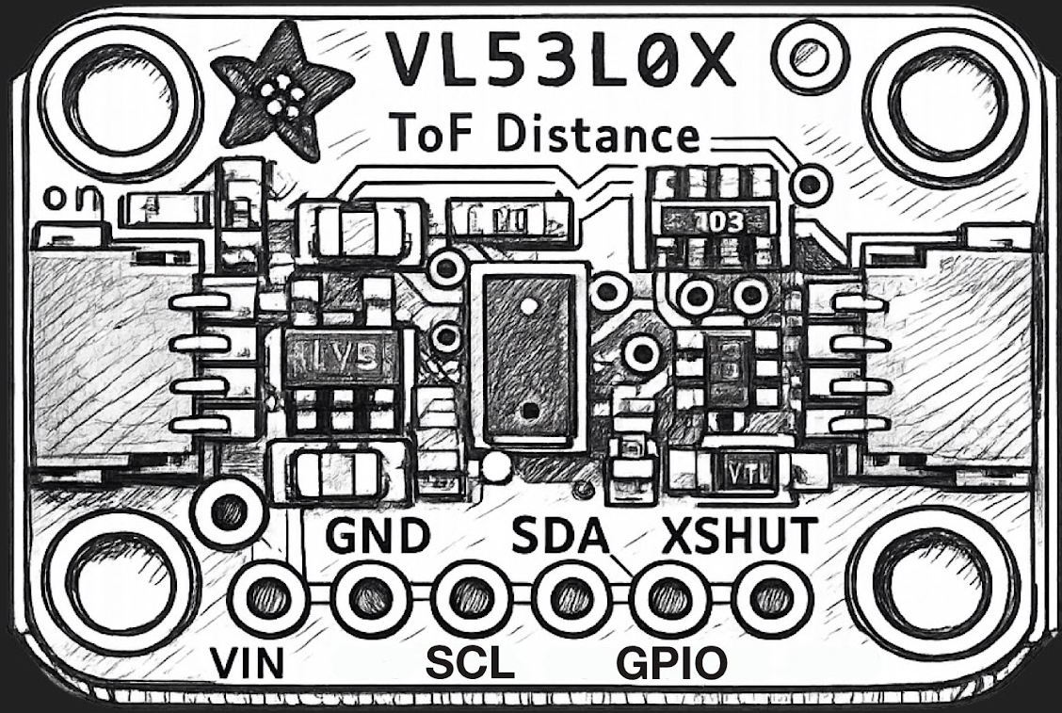
ToF Sensors
Sensors angled downwards for each door
Uses distance and change in distance to determine if someone goes in or out
Pros:
Cheap
Easy to program
Cons:
Bad with crowds
Detects all objects
Needs another system to ensure it works as intended

Slide 3
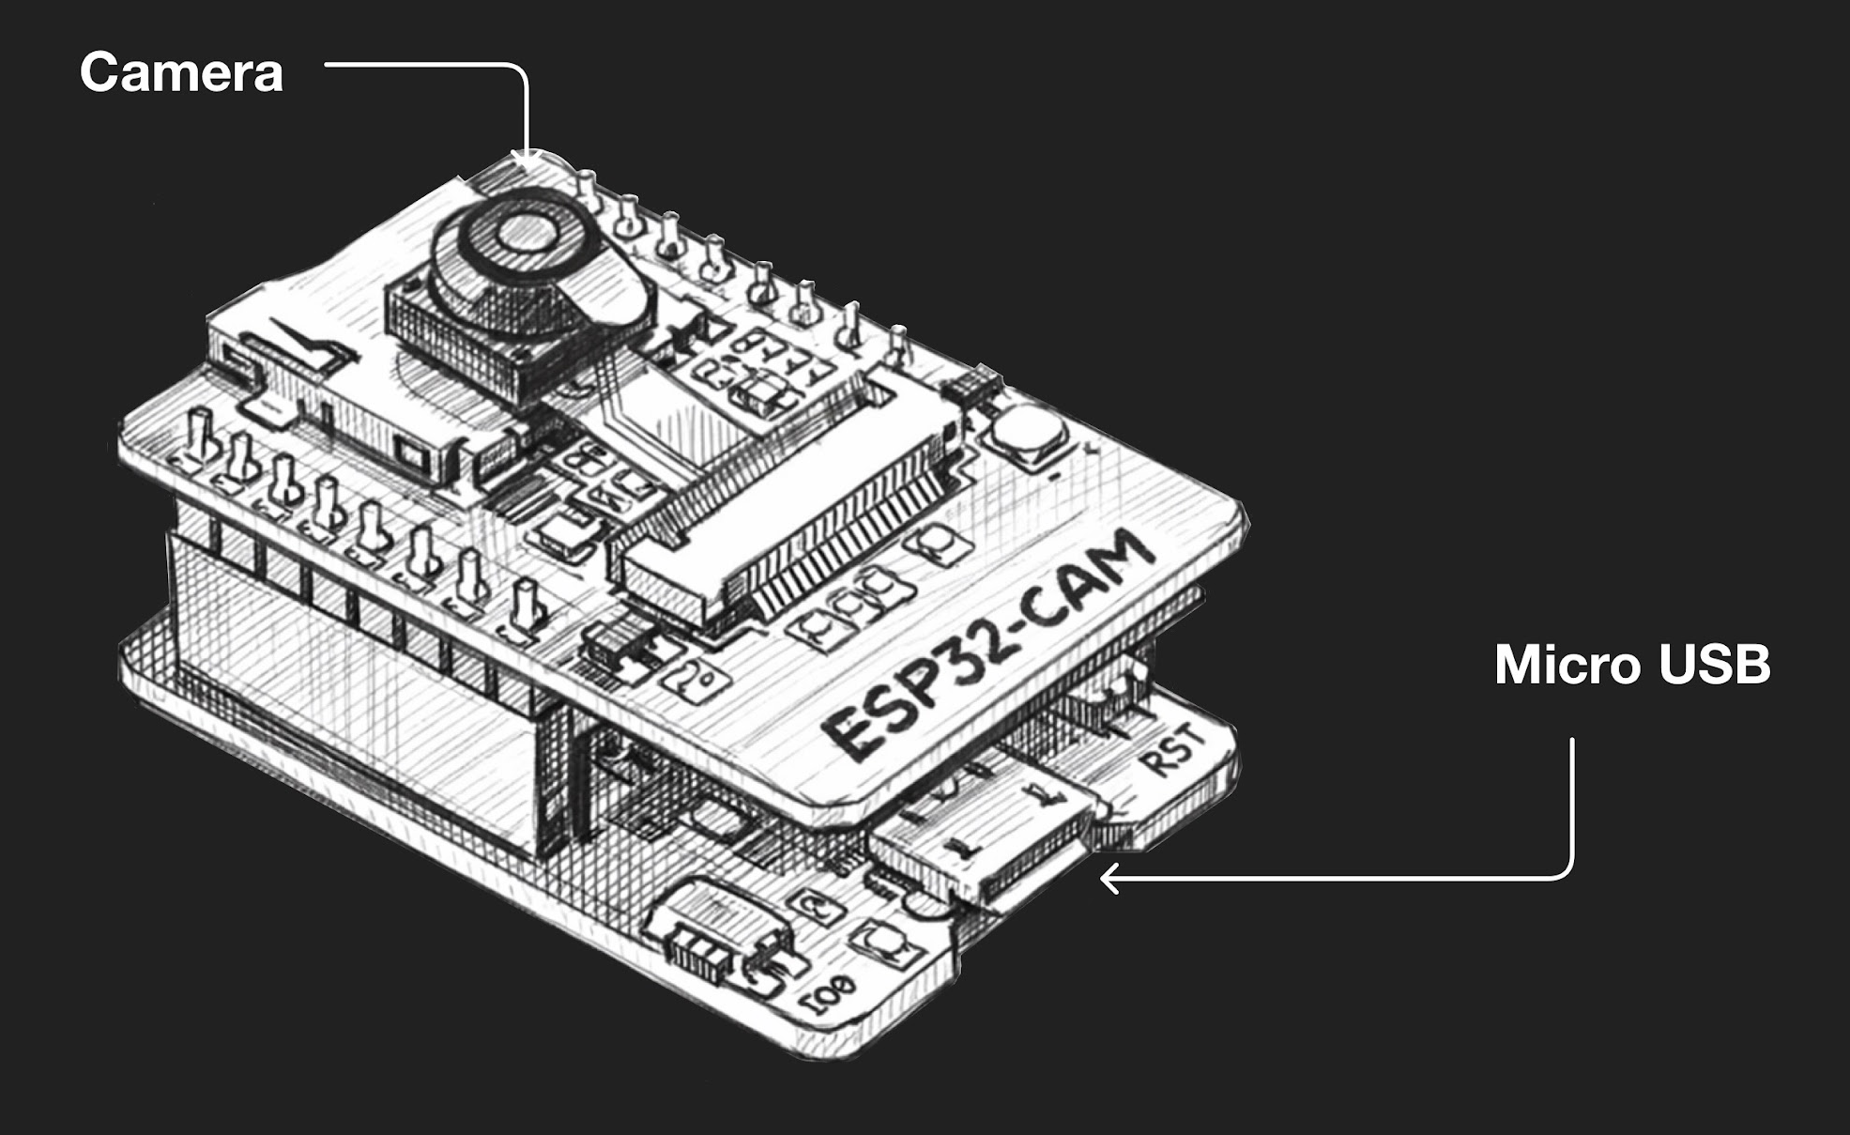
Camera with People Recognition
Top of doors angled down to detect people
Uses computational analysis to detect in or out
Pros:
Very accurate for single person
Only one needed
Cons:
Heavily reliant on good computation
Hard to do on ESP32
Bad with crowds
Expensive

Slide 4
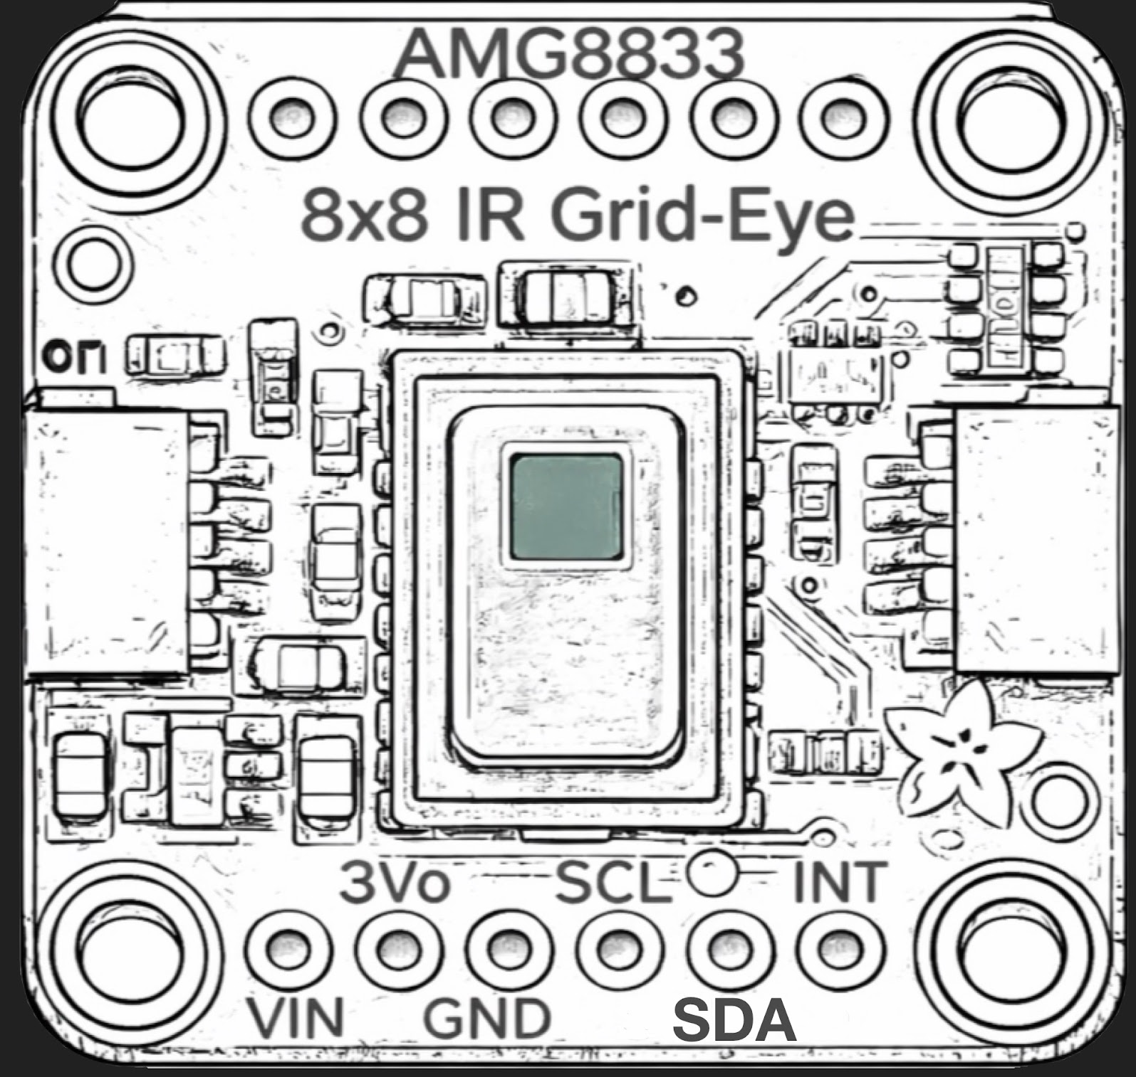
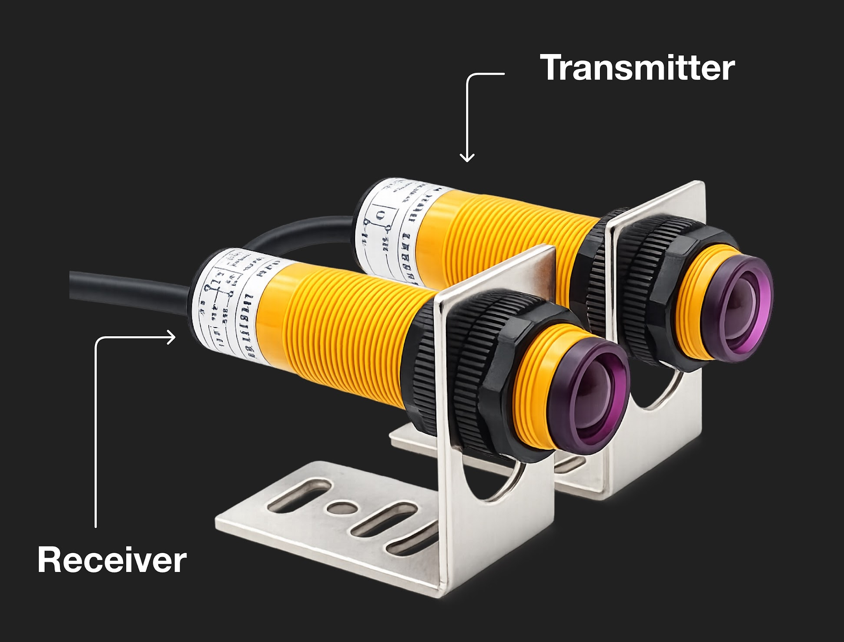
Thermal Camera with Tripwires
Thermal Camera at top of door with tripwires horizontally on the door
Tripwires to see if going in or out
Thermal for ensuring it is human
Pros:
Can detect all edge cases
2 systems able to do what the other cannot
Cons:
Can be difficult to program
Thermal camera harder to set up with the right angle

Slide 5
Top Ranked Design
Sensor Type | Accuracy (5) | Cost (2) | Power Consumption (4) | Feasibility (5) | Integration Complexity (3) | Total
Time of Flight | 3 | 4 | 2 | 3 | 3 | 55
Camera + People Recognition | 5 | 2 | 1 | 2 | 1 | 46
Thermal Camera + Tripwire | 4 | 2 | 4 | 4 | 3 | 73

Slide 6
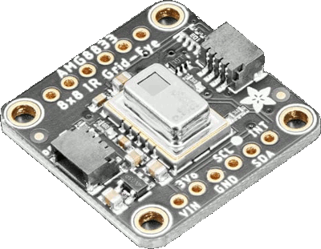
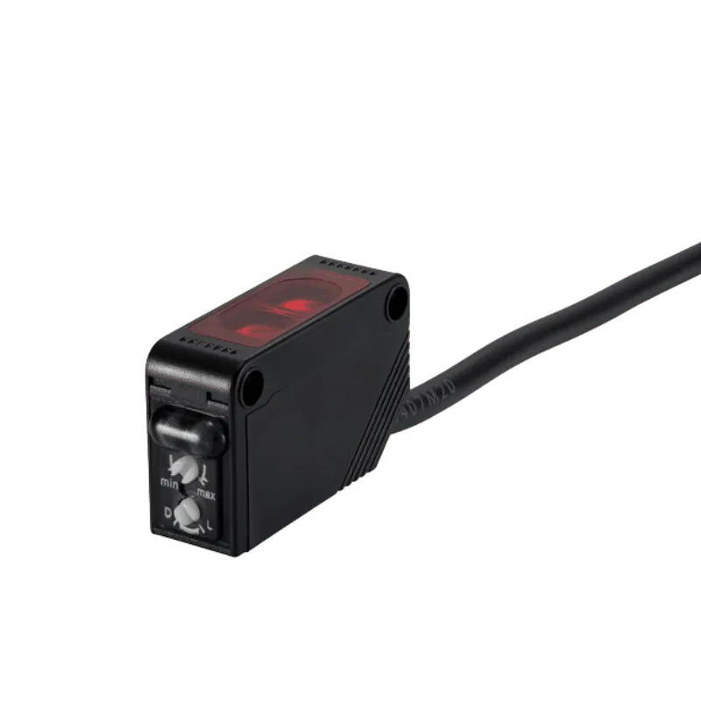
Component Numbers
Thermal Sensor- AMG8833
Tripwire- E3F series

Slide 7
Test #1 Setup
Setup basic hardware/install library
Write test code
Thermal Sensor
Adafruit AMG88xx library has test code
Tripwire
Output beam clear/broken from receiver state high/low
Test for latency & power consumption

Slide 8
Test #2 Tripwire detection accuracy (one person)
Objective: Validate tripwire reliably detects a single person crossing the doorway
Setup
2 horizontal + one angled sensor at trunk height
Timestamp logging for each sensor trigger
Crossing rule: event declared if ≥2 sensors trigger within 300ms

Slide 9
Test #2 Tripwire detection accuracy (one person)
Procedure
30 true crossings
10 slow walk + 10 normal walk + 10 fast walk
15 non-crossing trials
Walk near doorway but not cross
Pause at edge and step back
Door motion without crossing
Mertics
Detection Rate = TP / (TP + FN)
False trigger rate = FP / non-crossing trials
* TP: True Positive
FN: False Negative
FP: False Positive

Slide 10
Test #3 Tripwire direction (one person)
Objective: Verify sensor trigger order can determine directions (IN vs OUT)
Setup
Same tripwire configuration
Direction determined by trigger order or Δt between sensors
Log timestamps for all triggers

Slide 11
Test #3 Tripwire direction (one person)
Procedure
20 IN trials + 20 OUT trials
Mix of slow, normal, and fast walking
Metrics
Direction accuracy = correct predictions / total trials
Δt between sensors

Slide 12
Quantitative Performance AMG8833
Accuracy: 85-90% for basic human presence
Range: 2-3 m
Mounted top down
Resolution: 8*8 pixels
Might have some trouble distinguishing between multiple people
Latency: 100 ms per update
Power consumption: 4.5 mA at 3.3 V

Slide 13
Quantitative Performance E3F Sensors
Accuracy: >99% for triggers
Range: 5 m
Enough to cover door horizontally
Latency: 1.5-2.5 ms
Power consumption: 10-20 mA at 3.3 V
2 E3F sensors in use, double power

Slide 14
Quantitative Performance of The System
One person: >99%
Tripwire will trigger
Multiple people ~80%
Significant drop in accuracy
Improvements could be made by processing data
Tripwire trigger time and order
Heat map from thermal sensor
False positive for objects <10% (dependent on object)
Thermal sensor filters out low heat emitting objects
Tripwire filters out objects below waist level

Slide 15
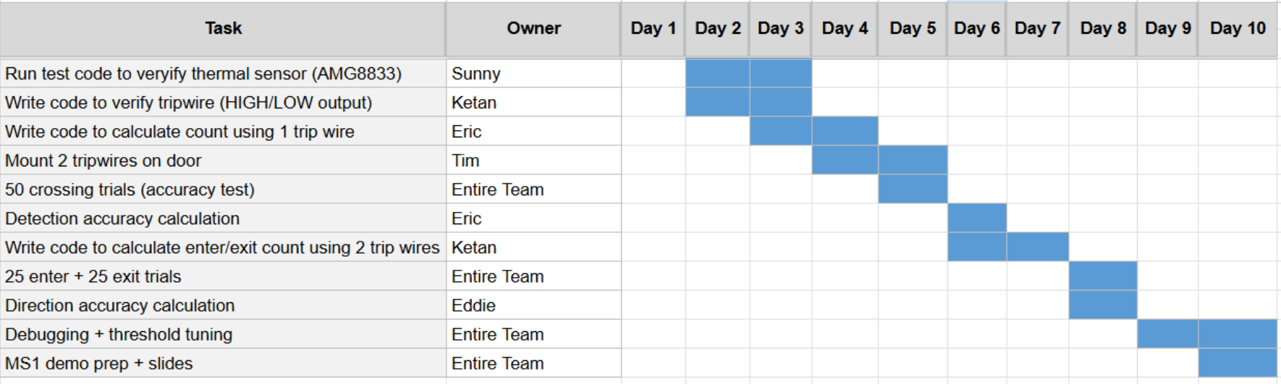
MS1 Testing Plan

Slide 16
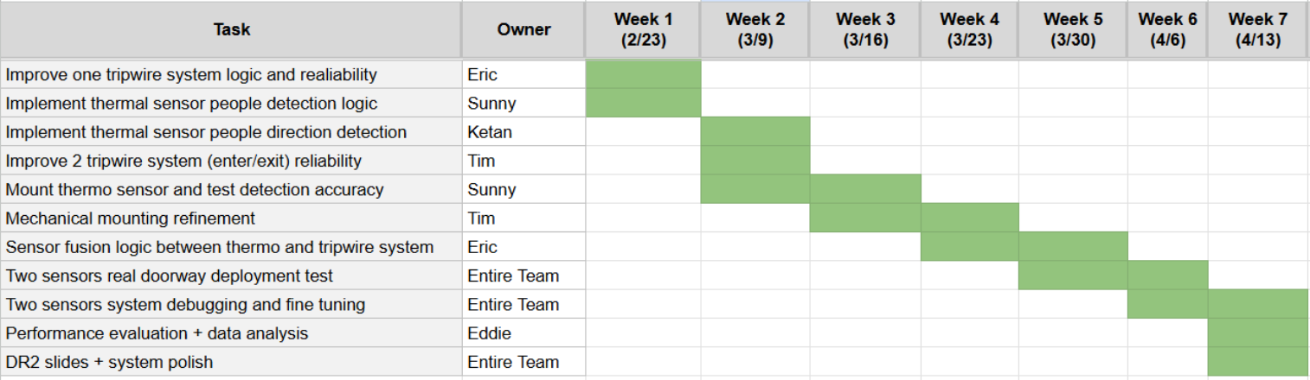
Long Term Project Plan

